Slide 1


Slide 2


Slide 3




STANDARD WORKFLOW
Explanatory Data Analysis
(EDA)
Preprocessing Data
Modelling

Slide 4


Explanatory Data Analysis (EDA)
- Research Domain Knowledge Data
- Understanding Every Feature in Data
- Check Data Properties
- Separate Variable
- Check Missing Value
- Visualization Simple Plot
- ETC

Slide 5

EDA: Research Domain Knowledge
Titanic Kapal Super Britania Raya yang Tenggelam di Samudra Atlantik Utara Pada 15 April 1912 dan Mengakibatkan Kematian 1.514 Penumpang

Slide 6
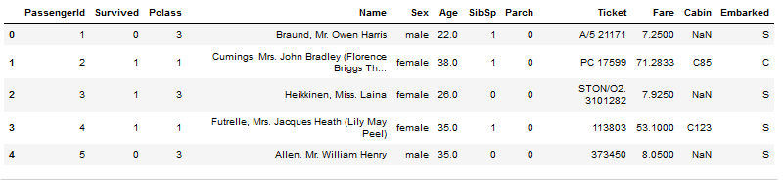
EDA : Understanding Every Feature in Data

Slide 7
EDA : Cek Data Properti
EDA : Cek Data Properti
EDA : Separate Variable
Cek jumlah column data
Cek jumlah row data
Check Type Data
ETC
Numberik
Categorik

Slide 8
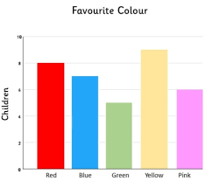
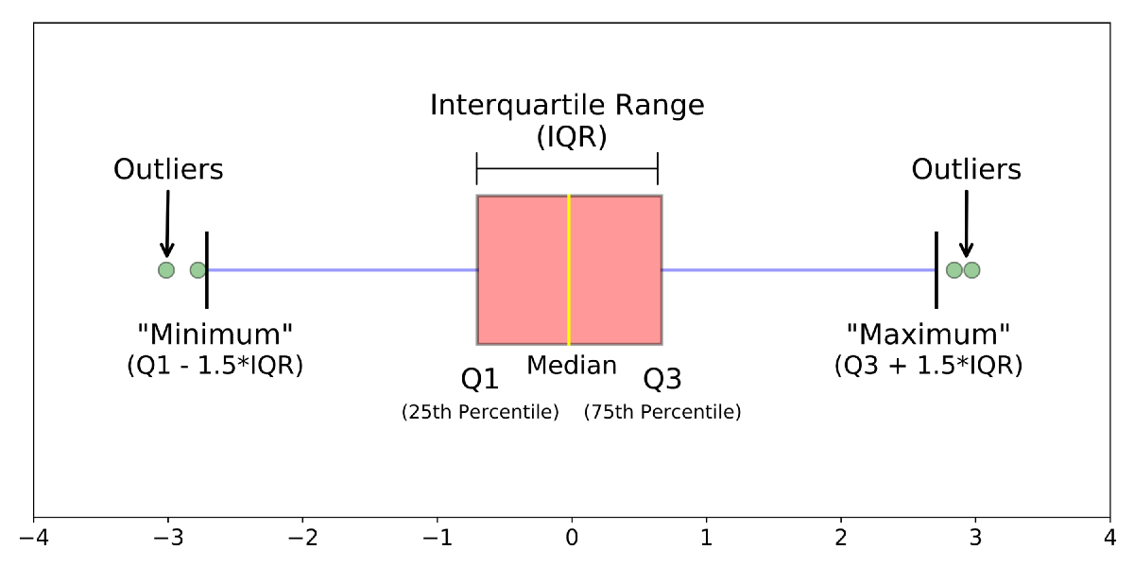
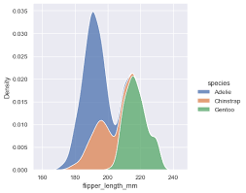
EDA - Check Mising Value
- Visualisation Simple Plot

Slide 9
Preprocessing Data
No | Umur Siswa
1 | 12
2 | 13
3 | 11
4 | NaN
No | Umur Siswa
1 | 12
2 | 13
3 | 11
4 | 12
Fill / Drop Missing Value
Convert Categorical Data To Numberical Data
Selected Variable/ Feature
No | Jenis Kelamin
1 | Male
2 | Female
3 | Male
4 | Male
No | Jenis Kelamin
1 | 1
2 | 0
3 | 1
4 | 0

Slide 10
Modelling
- Choose The Model
- Choose Parameter
- Doing Modelling
- Check your Accuracy Model

Slide 11
Simple Workflow
Explanatory Data Analysis | Preprocessing Data | Modelling
- Research Data - Understanding Data - Check Data Properties - Separate Variable - Check Missing Value - Visualization Simple Plot | - Fill/Drop Missing Value - Convert Categorical Data To Numberical Data - Selected Variable | - Choose The Model - Choose Parameter - Doing Modelling - Check Accuracy Model

Slide 12
Complete Flow Flow
Explanatory Data Analysis | Preprocessing Data | Modelling
- Research Data - Understanding Data - Check Data Properties - Separate Variable - Check Outlier - Check Missing Value - Visualization Simple Plot - Check Correlaction - Check Variance - Check Covariance - Statistical Hypothesis - Scatter Plot - Etc Explore Everyting do you can | - Fill/Drop Missing Value - Convert Categorical Data To Numberical Data - Feature Selection - Feature Extraction - Feature Transformation - Feature Scaling - Oversampling - Undersampling - Etc Try Every Features Engineering | - Choose The Model - Choose Parameter - Doing Modelling - Check Accuracy Model - Feature Importance - GridSearch Model - Ensembel Model - Optimizing Model - Etc Try Every Modelling until good enough

